Slide 1
Chapter 3: Supervised Learning

Slide 2
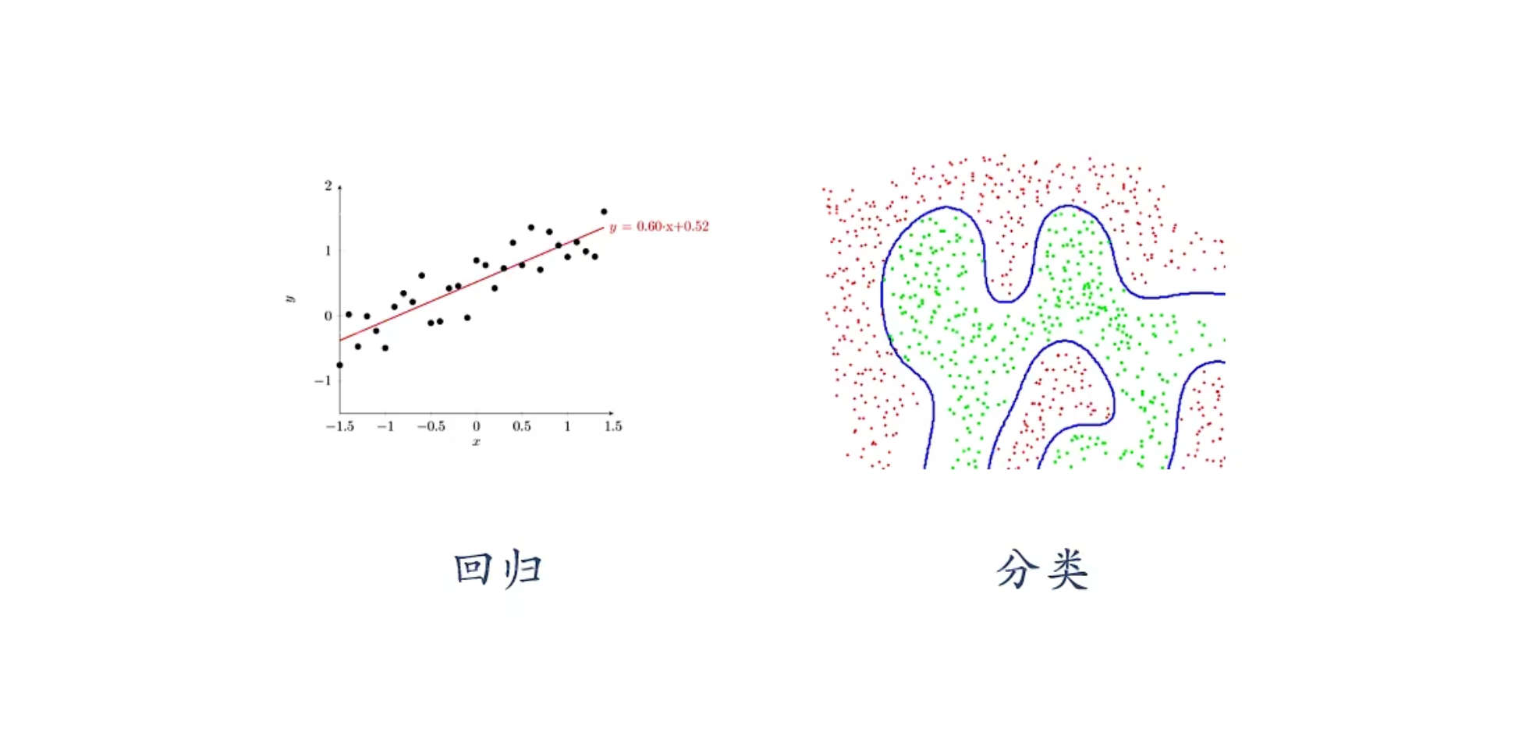
Typical Supervised Learning
Regression
Classification

Slide 3
Chapter 3.1: Logistic Regression

Slide 4
Outline
Classification
Cost function and gradient
Multi-class
Regularization

Slide 5

Classification
Email: Spam / Not Spam?
Online Transactions: Fraudulent (Yes / No)?
Tumor: Malignant / Benign ?
0: “Negative Class” (e.g., benign tumor)
1: “Positive Class” (e.g., malignant tumor)
$$y∈\{0,1\}$$

Slide 6

Classification
(Yes) 1
Malignant ?
(No) 0
Tumor Size
Tumor Size
Threshold classifier output $h_{θ}\left(x\right)$ at 0.5:
If $h_{θ}\left(x\right)≥0.5$, predict “$y = 1$”
If $h_{θ}\left(x\right)<0.5$, predict “$y = 0$”

Slide 7
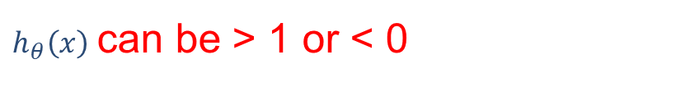
Classification
Classification: $y = 0$ or $1$
$h_{θ}\left(x\right)$ can be > 1 or < 0
Logistic Regression: ${0≤h}_{θ}\left(x\right)≤1$

Slide 8
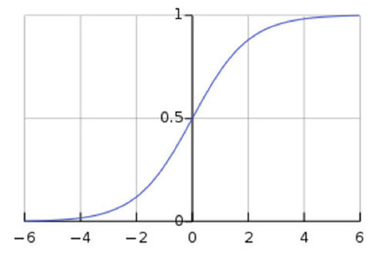
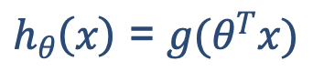
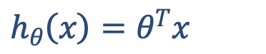

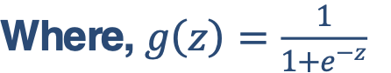
Hypothesis Representation
Logistic Regression Model
Want ${0≤h}_{θ}\left(x\right)≤1$
$h_{θ}\left(x\right)=θ^{T}x$
$h_{θ}\left(x\right)$ = $g(θ^{T}x)$
Where, $g\left(z\right)=\frac{1}{1+e^{−z}}$
Sigmoid function
Logistic function

Slide 9



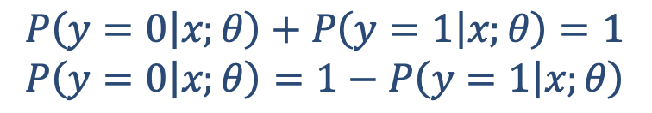
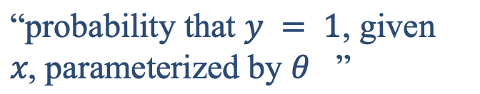
Interpretation of Hypothesis Output
$h_{θ}\left(x\right)$= estimated probability that y = 1 on input x
Example: If $x=\left[\begin{aligned}x_{0} \\ x_{1}\end{aligned}\right]=\left[\begin{aligned}1 \\ tumorSize\end{aligned}\right]$
$$h_{θ}\left(x\right)=0.7$$
Tell patient that 70% chance of tumor being malignant
“probability that $y = 1$, given $x$, parameterized by $θ$ ”
$$h_{θ}\left(x\right)=P(y=1|x;θ)$$
$$P\left(y=0 | x;θ\right)+P\left(y=1 | x;θ\right)=1$$
$$P\left(y=0 | x;θ\right)=1−P\left(y=1 | x;θ\right)$$

Slide 10
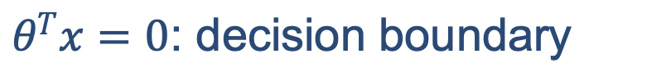
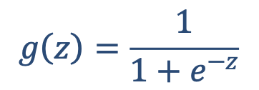
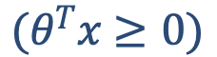
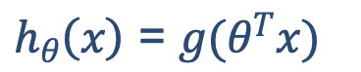
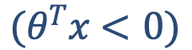
Decision boundary
Logistic regression
$h_{θ}\left(x\right)$ = $g(θ^{T}x)$
$$g\left(z\right)=\frac{1}{1+e^{−z}}$$
Suppose predict "$y=1"$ if $h_{θ}\left(x\right)≥0.5$
$$(θ^{T}x≥0)$$
predict $"y=0"$ if $h_{θ}\left(x\right)<0.5$
$$(θ^{T}x<0)$$
$θ^{T}x=0$: decision boundary

Slide 11
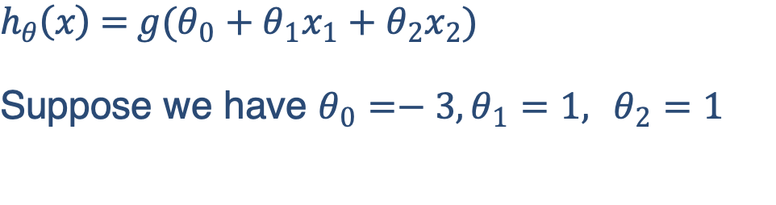
Decision boundary
x₂
$$h_{θ}\left(x\right) \text{= }g(θ_{0}+θ_{1}x_{1}+θ_{2}x_{2})$$
Suppose we have $θ_{0}=−3,θ_{1}=1, θ_{2}=1$
3
2
1
1
2
3
x₁
Predict “$y=1$” if $−3+x_{1}+x_{2}≥0$
Predict “$y=0$” otherwise

Slide 12
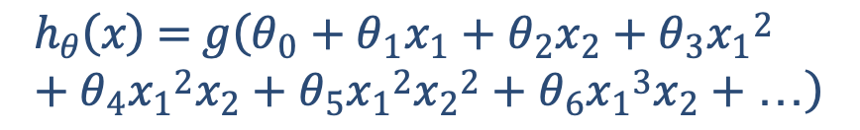
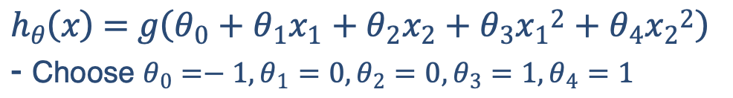
Non-linear decision boundaries
x₂
1
$$h_{θ}\left(x\right) \text{= }g\left(θ_{0}+θ_{1}x_{1}+θ_{2}x_{2}+θ_{3}{x_{1}}^{2}+θ_{4}{x_{2}}^{2}\right)$$
- Choose $θ_{0}=−1,θ_{1}=0,θ_{2}=0,θ_{3}=1,θ_{4}=1$
1
x₁
-1
-1
Predict “𝑦=1“ if $−1+{x_{1}}^{2}+{x_{2}}^{2}≥0$
Predict “𝑦=0” otherwise
x₂
$$h_{θ}\left(x\right) \text{= }g\left(θ_{0}+θ_{1}x_{1}+θ_{2}x_{2}+θ_{3}{x_{1}}^{2}+θ_{4}{x_{1}}^{2}x_{2}+θ_{5}{x_{1}}^{2}{x_{2}}^{2}+θ_{6}{x_{1}}^{3}x_{2}+…\right)$$
x₁

Slide 13
Outline
Classification
Cost function and gradient
Multi-class
Regularization

Slide 14
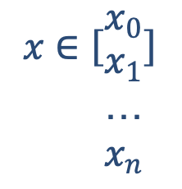
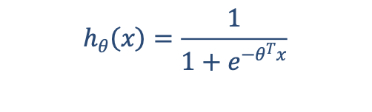

Cost function
Training set:$\left\{\left(x^{\left(1\right)}\text{, }y^{\left(1\right)}\right),\left(x^{\left(2\right)}\text{, }y^{\left(2\right)}\right),…,\left(x^{\left(m\right)}\text{, }y^{\left(m\right)}\right)\right\}$
$$x∈\left[{x_{0} \atop \begin{aligned}x_{1} \\ … \\ x_{n}\end{aligned}}\right]$$
m examples
$$x_{0}=1,y∈\left\{0,1\right\}$$
$$h_{θ}\left(x\right)=\frac{1}{1+e^{−θ^{T}x}}$$
How to choose parameters $θ$?

Slide 15


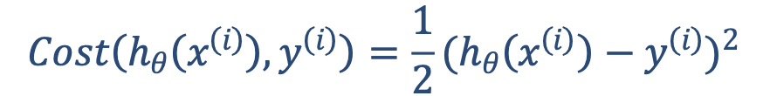
Cost function
Linear regression:$J\left(θ\right)=\frac{1}{m}\sum_{i=1}^{m}{\frac{1}{2}{(h_{θ}\left(x^{\left(i\right)}\right)−y^{\left(i\right)})}^{2}}$
We don’t use SSE error for training classification model, why? -> Gradient vanishing.
$$Cost\left(h_{θ}\left(x^{\left(i\right)}\right),y^{\left(i\right)}\right)=\frac{1}{2}{(h_{θ}\left(x^{\left(i\right)}\right)−y^{\left(i\right)})}^{2}$$
“non-convex”
“convex”
Gradient of \theta if using SSE: $2\left(y – y’\right)× y’ × \left(1−y’\right)× x.$

Slide 16
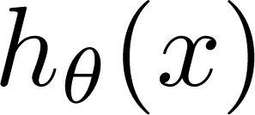

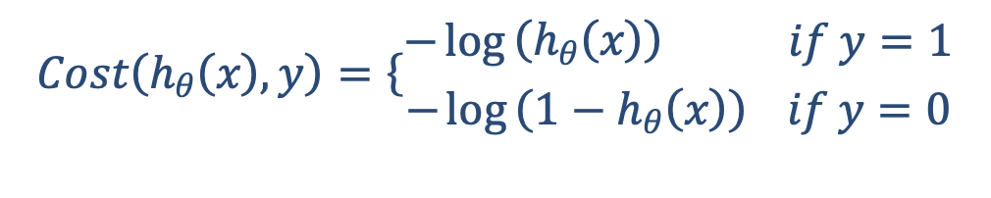
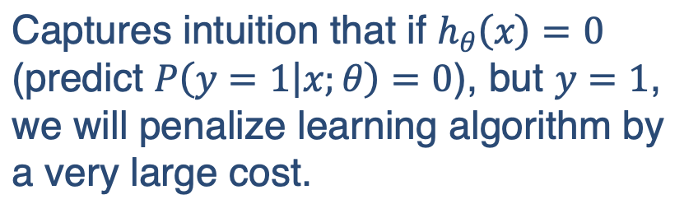

Logistic regression cost function
$$Cost\left(h_{θ}\left(x\right),y\right)=\left\{\begin{aligned}−\log\left(h_{θ}\left(x\right)\right) if y=1 \\ −\log\left(1−h_{θ}\left(x\right)\right) if y=0\end{aligned}\right.$$
If y = 1
$Cost=0$ if $y=1,h_{θ}\left(x\right)=1$
But, as $h_{θ}\left(x\right)→0, Cost→∞$
Captures intuition that if $h_{θ}\left(x\right)=0$ (predict $P\left(y=1 | x;θ\right)=0$), but $y=1$, we will penalize learning algorithm by a very large cost.
0
1
Notes:
If the ground truth label is 1, we want h_{\theta}(x) to be close to 1, so we penalize if h_{\theta}(x) goes towards 0.

Slide 17
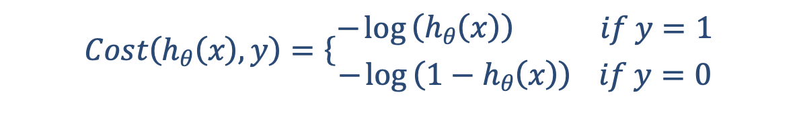
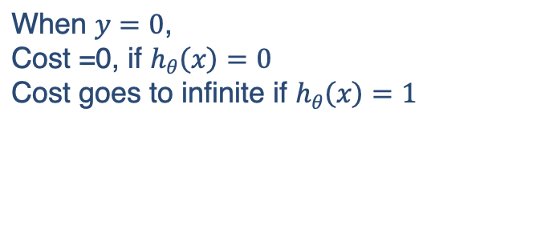
Logistic regression cost function
$$Cost\left(h_{θ}\left(x\right),y\right)=\left\{\begin{aligned}−\log\left(h_{θ}\left(x\right)\right) if y=1 \\ −\log\left(1−h_{θ}\left(x\right)\right) if y=0\end{aligned}\right.$$
If y =0
When $y=0$,
Cost =0, if $h_{θ}\left(x\right)=0$
Cost goes to infinite if $h_{θ}\left(x\right)=1$
0
1

Slide 18
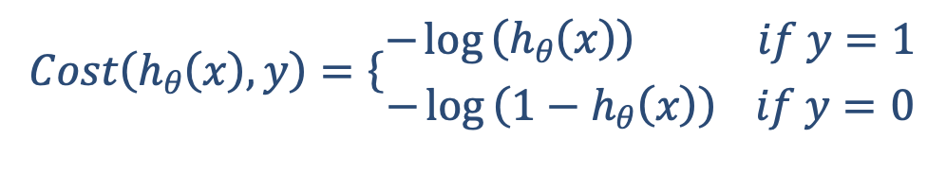
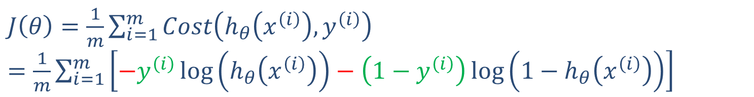
Logistic regression cost function
Simplification:
$J\left(θ\right)=\frac{1}{m}\sum_{i=1}^{m}{Cost\left(h_{θ}\left(x^{\left(i\right)}\right),y^{\left(i\right)}\right) }$
$$Cost\left(h_{θ}\left(x\right),y\right)=\left\{\begin{aligned}−\log\left(h_{θ}\left(x\right)\right) if y=1 \\ −\log\left(1−h_{θ}\left(x\right)\right) if y=0\end{aligned}\right.$$
Note: $y=0$ or $1$ always
$J\left(θ\right)=\frac{1}{m}\sum_{i=1}^{m}{Cost\left(h_{θ}\left(x^{\left(i\right)}\right),y^{\left(i\right)}\right) }$
$=\frac{1}{m}\sum_{i=1}^{m}{\left[−y^{\left(i\right)}\log\left(h_{θ}\left(x^{\left(i\right)}\right)\right)−\left(1−y^{\left(i\right)}\right)\log\left(1−h_{θ}\left(x^{\left(i\right)}\right)\right)\right]}$

Slide 19

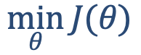
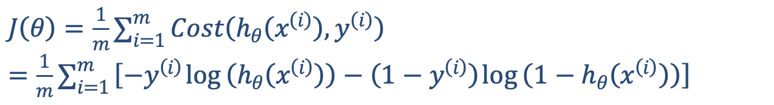
Logistic regression cost function
$J\left(θ\right)=\frac{1}{m}\sum_{i=1}^{m}{Cost\left(h_{θ}\left(x^{\left(i\right)}\right),y^{\left(i\right)}\right) }$
$=\frac{1}{m}\sum_{i=1}^{m}{\left[{−y}^{\left(i\right)}\log\left(h_{θ}\left(x^{\left(i\right)}\right)\right)−\left(1−y^{\left(i\right)}\right)\log\left(1−h_{θ}\left(x^{\left(i\right)}\right)\right)\right]}$
To fit parameters $θ$ :
$$\min_{θ}{J(θ)}$$
To make a prediction given new $x$ :
Output $h_{θ}\left(x\right)=\frac{1}{1+e^{−θ^{T}x}}$

Slide 20



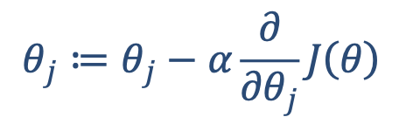

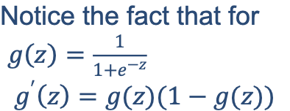
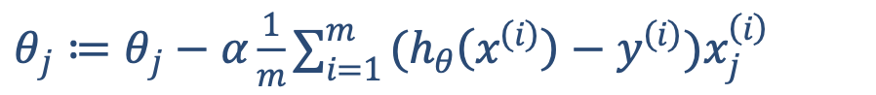
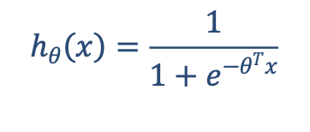
Gradient Descent
$J\left(θ\right)=\frac{1}{m}\sum_{i=1}^{m}{\left[{−y}^{\left(i\right)}\log\left(h_{θ}\left(x^{\left(i\right)}\right)\right)−\left(1−y^{\left(i\right)}\right)\log\left(1−h_{θ}\left(x^{\left(i\right)}\right)\right)\right]}$
Want $\min_{θ}{J(θ)}$:
Repeat
$$θ_{j}≔θ_{j}−α\frac{∂}{∂θ_{j}}J\left(θ\right)$$
Notice the fact that for
$g\left(z\right)=\frac{1}{1+e^{−z}}$
$$g^{′}\left(z\right)=g(z)(1−g(z))$$
(simultaneously update all $θ_{j}$ )
Repeat
$θ_{j}≔θ_{j}−α\frac{1}{m}\sum_{i=1}^{m}{(h_{θ}\left(x^{\left(i\right)}\right)−y^{\left(i\right)})x_{j}^{\left(i\right)}}$
$$h_{θ}\left(x\right)=\frac{1}{1+e^{−θ^{T}x}}$$
(simultaneously update all $θ_{j}$)
Algorithm looks identical to linear regression!
Gradient of \theta: $− (y’ – y) x$

Slide 21
Outline
Classification
Cost function and gradient
Multi-class
Regularization

Slide 22
Multiclass classification
Email foldering/tagging: Work, Friends, Family, Hobby
Medical diagrams: Not ill, Cold, Flu, Coro-V
Weather: Sunny, Cloudy, Rain, Snow

Slide 23
Multiclass classification
Binary classification:
Multi-class classification:
x₂
x₂
x₁
x₁

Slide 24
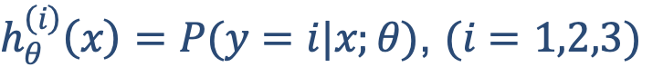
Multiclass classification
x₂
One-vs-all (one-vs-rest):
x₁
x₂
x₂
x₁
x₁
Class 1:
Class 2:
Class 3:
x₂
x₁
$h_{θ}^{\left(i\right)}\left(x\right)=P(y=i|x;θ)$, $(i=1,2,3)$

Slide 25

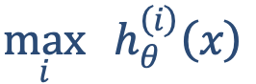

Multiclass classification
Train a logistic regression classifier $h_{θ}^{\left(i\right)}\left(x\right)$ for each class $i$ to predict the probability that $y=i$.
On a new input $x$, to make a prediction, pick the class $i$ that maximizes $h_{θ}^{\left(i\right)}\left(x\right)$
$$\max_{i}{h_{θ}^{\left(i\right)}\left(x\right)}$$
Optional: train only ONE classifier with a softmax function

Slide 26
Outline
Classification
Cost function and gradient
Multi-class
Regularization

Slide 27
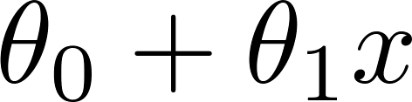
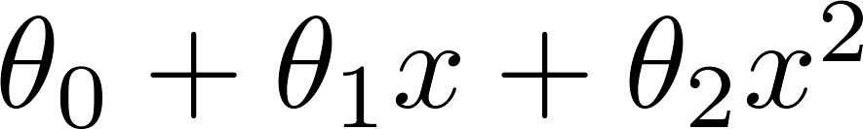
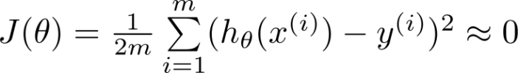
Regularization-The problem of overfitting
Example: Linear regression (housing prices)
Price
Price
Price
Size
Size
Size
Overfitting: If we have too many features, the learned hypothesis may fit the training set very well ( ), but fail to generalize to new examples (predict prices on new examples).

Slide 28
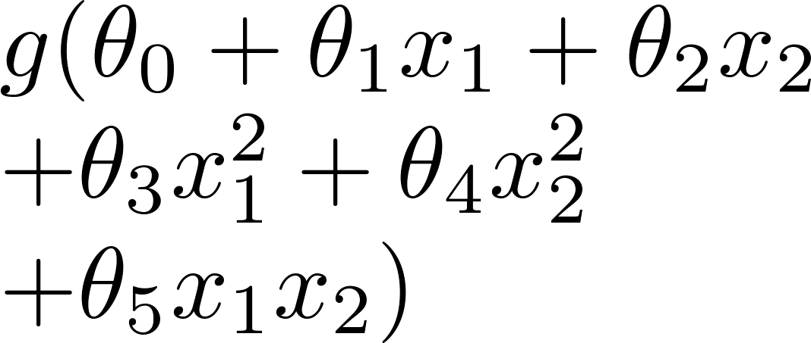
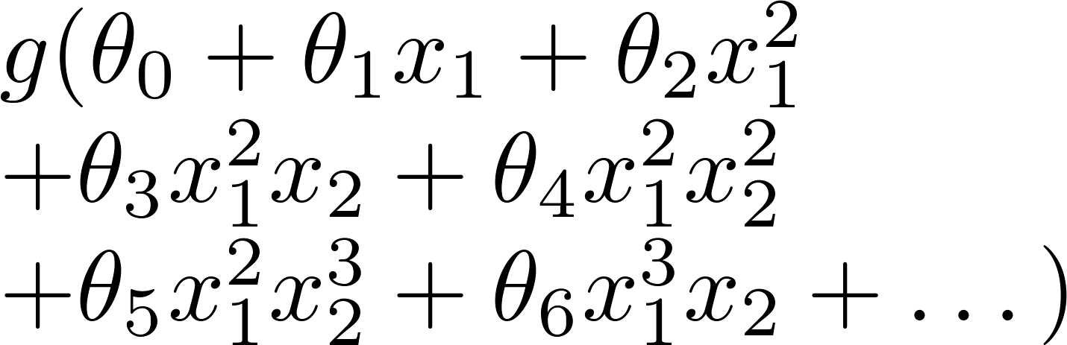
Example: Logistic regression
x₂
x₂
x₂
x₁
x₁
x₁
( = sigmoid function)

Slide 29
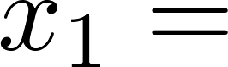
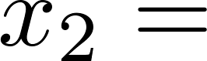
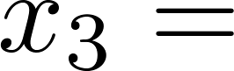
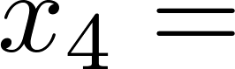
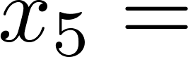
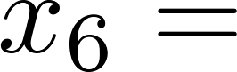
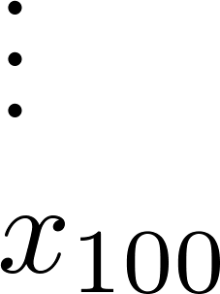
Addressing overfitting
size of house
no. of bedrooms
no. of floors
Price
age of house
average income in neighborhood
Size
kitchen size

Slide 30
Addressing overfitting
Options:
Reduce number of features.
Manually select which features to keep.
Model selection algorithm.
Regularization.
Keep all the features, but reduce magnitude/values of parameters.
Works well when we have a lot of features, each of which contributes a bit to predicting.

Slide 31
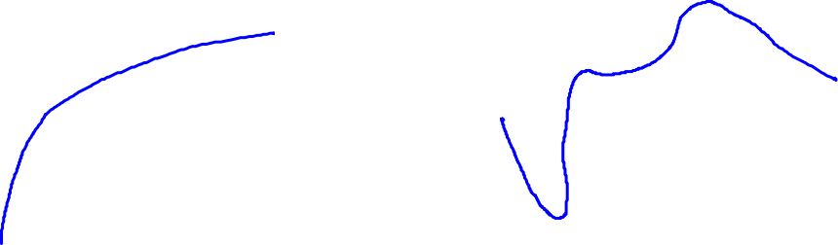
Intuition
Price
Price
Size of house
Size of house
$\min_{θ}{\frac{1}{2m}\sum_{i=1}^{m}{{\left(h_{θ}\left(x^{\left(i\right)}\right)−y^{(i)}\right)}^{2}+1000θ_{3}^{2}+1000θ_{4}^{2} }}$

Slide 32
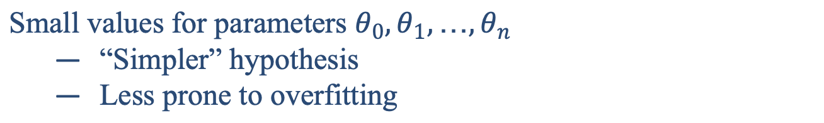
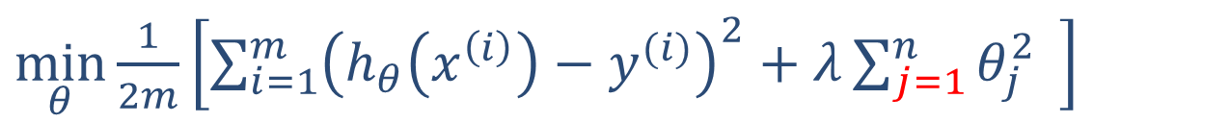

Regularization
Small values for parameters $θ_{0},θ_{1},…,θ_{n}$
“Simpler” hypothesis
Less prone to overfitting
Housing:
Features: $x_{0},x_{1},…,x_{100}$
Parameters:${ θ}_{0},θ_{1},…,θ_{100}$
$\min_{θ}{\frac{1}{2m}\left[\sum_{i=1}^{m}{{\left(h_{θ}\left(x^{\left(i\right)}\right)−y^{(i)}\right)}^{2}+λ\sum_{j=1}^{n}{θ_{j}^{2}} }\right]}$

Slide 33

Regularization
$\min_{θ}{\frac{1}{2m}\left[\sum_{i=1}^{m}{{\left(h_{θ}\left(x^{\left(i\right)}\right)−y^{(i)}\right)}^{2}+λ\sum_{j=1}^{n}{θ_{j}^{2}} }\right]}$
$$\min_{θ}{J(θ)}$$
The two parts in the cost function make a balance between bias and variance, so that the model doesn’t go underfitting or overfitting too much
Price
Size of house

Slide 34
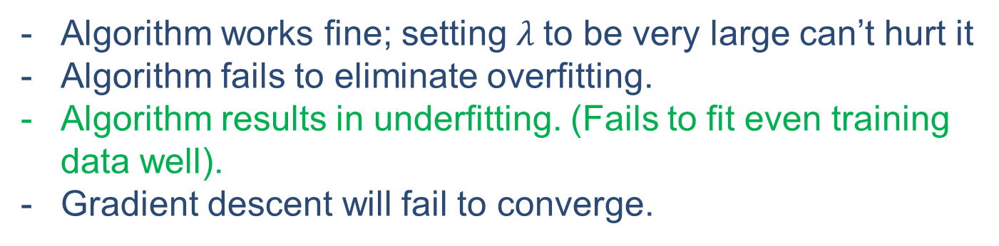

Regularization
In regularized linear regression, we choose $θ$ to minimize
$\min_{θ}{\frac{1}{2m}\left[\sum_{i=1}^{m}{{\left(h_{θ}\left(x^{\left(i\right)}\right)−y^{(i)}\right)}^{2}+λ\sum_{j=1}^{n}{θ_{j}^{2}} }\right]}$
What if $λ$ is set to an extremely large value (perhaps for too large for our problem, say $λ={10}^{10}$)?
Algorithm works fine; setting $λ$to be very large can’t hurt it
Algorithm fails to eliminate overfitting.
Algorithm results in underfitting. (Fails to fit even training data well).
Gradient descent will fail to converge.

Slide 35

Regularization
In regularized linear regression, we choose $θ$ to minimize
$\min_{θ}{\frac{1}{2m}\left[\sum_{i=1}^{m}{{\left(h_{θ}\left(x^{\left(i\right)}\right)−y^{(i)}\right)}^{2}+λ\sum_{j=1}^{n}{θ_{j}^{2}} }\right]}$
What if $λ$is set to an extremely large value (perhaps for too large for our problem, say $λ={10}^{10}$)?
Price
underfit
Size of house
All theta are penalized to almost 0

Slide 36




Regularization: linear regression
$\min_{θ}{\frac{1}{2m}\left[\sum_{i=1}^{m}{{\left(h_{θ}\left(x^{\left(i\right)}\right)−y^{(i)}\right)}^{2}+λ\sum_{j=1}^{n}{θ_{j}^{2}} }\right]}$
$$\min_{θ}{J(θ)}$$
Gradient descent
Repeat
$θ_{0}≔θ_{0}−α\frac{1}{m}\sum_{i=1}^{m}{(h_{θ}\left(x^{\left(i\right)}\right)−y^{\left(i\right)})x_{0}^{\left(i\right)}}$
$θ_{j}≔θ_{j}−α\frac{1}{m}\sum_{i=1}^{m}{\left(h_{θ}\left(x^{\left(i\right)}\right)−y^{\left(i\right)}\right)x_{j}^{\left(i\right)}}−α\frac{λ}{m}θ_{j}$
$$(j=1,2,…,n)$$
$θ_{j}≔θ_{j}\left(1−α\frac{λ}{m}\right)−α\frac{1}{m}\sum_{i=1}^{m}{\left(h_{θ}\left(x^{\left(i\right)}\right)−y^{\left(i\right)}\right)x_{j}^{\left(i\right)}}$

Slide 37


Regularization: logistic regression
x₂
x₁
Cost function:
$J\left(θ\right)=\frac{1}{m}\sum_{i=1}^{m}{\left[{−y}^{\left(i\right)}\log\left(h_{θ}\left(x^{\left(i\right)}\right)\right)−\left(1−y^{\left(i\right)}\right)\log\left(1−h_{θ}\left(x^{\left(i\right)}\right)\right)\right]+\frac{λ}{2m}\sum_{j=1}^{n}{θ_{j}^{2}}}$

Slide 38



Regularization: logistic regression
Gradient descent
Repeat
$θ_{0}≔θ_{0}−α\frac{1}{m}\sum_{i=1}^{m}{(h_{θ}\left(x^{\left(i\right)}\right)−y^{\left(i\right)})x_{0}^{\left(i\right)}}$
$θ_{j}≔θ_{j}−α\frac{1}{m}\sum_{i=1}^{m}{\left(h_{θ}\left(x^{\left(i\right)}\right)−y^{\left(i\right)}\right)x_{j}^{\left(i\right)}}−α\frac{λ}{m}θ_{j}$
$$(j=1,2,…,n)$$
The above gradient formula looks exactly like what we have in linear regression, the only difference is the form of $h_{θ}\left(x^{\left(i\right)}\right)$.

Slide 39
Chapter 3.2: Support Vector Machine

Slide 40
Outline
Support vector machine model
Constrained optimization
Soft margin
Kernel methods

Slide 41
Linear Separators
Binary classification can be viewed as the task of separating classes in feature space:
w^{T}x + b = 0
w^{T}x + b > 0
w^{T}x + b < 0
f(x) = sign(w^{T}x + b)

Slide 42
Which of the linear separators is optimal?

Slide 43




Classification Margin
Distance from example x_{i} to the separator is $d=\frac{|w^{T}x+b|}{\left\|w\right\|}$.
Examples closest to the hyperplane are support vectors.
Margin $γ$ of the separator is the distance between support vectors.
r
$$\left(x −x^{∗}\right)=λw$$
$$x^{∗}=x −λw$$
$$w^{T}x^{∗}+b=0$$
$$w^{T}\left(x −λw\right)+b=0$$
$$λ= \frac{w^{T}x+b}{{\left|\left|w\right|\right|}^{2}}$$
$$\left|\left|x −x^{∗}\right|\right|=\left|\left|λw\right|\right|=\left|λ\right|∗\left|\left|w\right|\right|=d$$
$$x$$
$$x^{∗}$$

Slide 44
Maximum Margin Classification
Maximizing the margin is good according to intuition and probably approximately correct (PAC) theory.
Implies that only support vectors matter; other training examples are ignorable.

Slide 45
Goal of SVM
The goal is to find the decision boundary with maximum margin
SVM also called large margin classifier
This line (hyperplane) not only separates the two classes but also stays as far away from the closest training instances as possible
optimal hyperplane
maximum margin

Slide 46

Linear SVM Mathematically
Training set $\left\{\left(x_{1},y_{1}\right),\left(x_{2},y_{2}\right),…, (\left(x_{n},y_{n}\right))\right\}$
$x_{i}εℝ^{m}$: input features
$y_{i}ε\{±1\}$: input label
Assume that the problem is linearly separable
there exists a linear surface to separate the two classes
2-D: line; 3-D: plane; ... ; n-D: hyperplane ($w^{T}x+b=0$)
$w=(w_{1},w_{2},…,w_{n})$: weight vector
$b$: scalar
Find a hyperplane that perfectly separates the two classes

Slide 47


Distance of a Point to Hyperplane
A hyperplane is defined through $w$ and $b$ as a set of points such that $ℋ=\left\{x|w^{T}x+b=0\right\}$
$w=(w_{1},w_{2},…,w_{n})$: weight vector
$b$: scalar
What is the distance ($d$) of a point $x$ to hyperplane $ℋ$?
$d=\frac{|w^{T}x+b|}{\left\|w\right\|}$, $\left\|w\right\|$ is the norm/length of the vector
Margin of $ℋ$ with respect to $D$ (training set):
$γ\left(w,b\right)=\min_{xεD}{\frac{2|w^{T}x+b|}{\left\|w\right\|}}$
The margin and hyperplane are scale invariant:
$γ\left(βw,βb\right)=γ\left(w,b\right), ∀β≠0$
Why $2|w^{T}x+b|$ here? This derivation contains several step.
Find the support vectors for +1 and -1 labels (resulting 2 support vectors (at least) ).
Given a hyperplane, compute $w^{T}x+b$ for two supporting vectors.
Results will be two real numbers, e.g., +3.5, -1.2. However, we prefer a hyperplane, such that $w^{T}x+b$ = +1 and -1 for this two supporting vectors.
Step 3 results in another constraint in the optimization process, which is introduced later in page 49, and relies on the “scale invariant” property.
Then, we can use $\frac{2|w^{T}x+b|}{\left\|w\right\|}$= $\frac{2}{\left\|w\right\|}$to denote the distance between two supporting vectors.
f(x) = sign(w^{T}x + b) = sign($β$w^{T}x +$β$b) = sign($β$ (w^{T}x +b) ), $β>0$

Slide 48

Optimization Problem
We can formulate our search for the maximum margin separating hyperplane as a constrained optimization problem
The objective is to maximize the margin under the constraints that all data points must lie on the correct side of their hyperplane:
$${\max_{w,b}{γ(w,b)} \atop s.t. y_{i}\left(w^{T}x_{i}+b\right)≥0, ∀i}$$

Slide 49

Optimization Problem
Because the hyperplane is scale invariant, we can fix the scale of $w,b$ anyway we want. Let’s choose it such that
$$\min_{xεD}\left|w^{T}x+b\right|=1$$
Then our objective becomes:
$$\max_{w,b}{γ(w,b)}=\max_{w,b}\left\{\min_{xεD}{\frac{2|w^{T}x+b|}{\left\|w\right\|}}\right\}=\max_{w,b}\frac{2}{\left\|w\right\|}$$
The constraints are:
$$y_{i}\left(w^{T}x_{i}+b\right)≥0, ∀i$$
$$\min_{xεD}\left|w^{T}x+b\right|=1$$

Slide 50


SVM model
Consider the constraints:
$$y_{i}\left(w^{T}x_{i}+b\right)≥0, ∀i$$
$$\min_{xεD}\left|w^{T}x+b\right|=1$$
$w^{T}x_{i}+b$ $\left\{\begin{aligned}≥0 ∧ ≥ 1 if y_{i}=1 \\ ≤0 ∧ ≤−1 if y_{i}=−1\end{aligned}\right.$
Therefore, the two constraints can be represented by:
$$y_{i}\left(w^{T}x_{i}+b\right)≥1, ∀i$$
The optimization problem is equivalent to a simpler formulation (SVM model):
$${\min_{w,b}{\frac{1}{2}{\left\|w\right\|}^{2}} \atop s.t. y_{i}\left(w^{T}x_{i}+b\right)≥1, ∀i}$$
This can be solved with quadratic programming algorithm using Lagrange multipliers.
Because the minimum absolute value is 1,
so $w^{T}x_{i}+b$ >= 1 or <= -1

Slide 51

Lagrange Multiplier (Optional)
Consider a problem of the following form:
$${\min_{w}{f(w)} \atop s.t. { h}_{i}\left(w\right)=0, i=1,…,l}$$
Use the Lagrange multiplier method to solve the problem
Define the Lagrangian to be $ℒ\left(w,β\right)=f\left(w\right)+\sum_{i=1}^{l}{β_{i}}{ h}_{i}\left(w\right)$
$β_{i}$'s are called the Lagrange multipliers
Then solve the problem by set $ℒ$ partial derivative to 0, $\frac{∂ℒ}{∂w}=0$, $\frac{∂ℒ}{∂β_{i}}=0$
Notes:
In mathematical optimization, the method of Lagrange multipliers is a strategy for finding the local maxima and minima of a function subject to equality constraints (i.e., subject to the condition that one or more equations have to be satisfied exactly by the chosen values of the variables).

Slide 52

Lagrange Multiplier (Optional)
Find the maximum and minimum values of $f\left(x,y\right)=3x−4y$ subject to the constraint $x^{2}+{3y}^{2}−129=0$.
Lagrangian: $ℒ\left(x,y,β\right)=3x−4y+β\left(x^{2}+{3y}^{2}−129\right)$
Find critical points
$\frac{∂ℒ}{∂x}=3+2βx=0$
$\frac{∂ℒ}{∂y}=−4+6βy=0$
$\frac{∂ℒ}{∂β}=x^{2}+{3y}^{2}−129=0$
$β=±\frac{1}{6}$, two critical points $\left\{x=−9,y=4\right\}$, $\left\{x=9,y=−4\right\}$
Plug these into the function
$f\left(−9,4\right)=−43$ (minimum)
$f\left(9,−4\right)=43$(maximum)
Notes:
In calculus, the extreme value theorem states that if a real-valued function f is continuous on the closed interval [a,b], then f must attain a maximum and a minimum, each at least once.
We can find maximum and minimum values of a function f(x) at its critical points. Critical points of a function are those where its derivative either zero or undefined (i. e. corner of a function).

Slide 53
Duality (Optional)
In optimization theory, duality means that optimization problems may be viewed from either of two perspectives, the primal problem or the dual problem.
The solution to the dual problem provides a lower bound to the solution of the primal (minimization) problem.
If you have a minimization problem, you can also see it as a maximization problem. And when you find the maximum of this problem, it will be a lower bound to the solution of the minimization problem.

Slide 54


Duality (Optional)
Sometimes, solving the dual problem is simpler than solving the primal problem.
Under certain convexity assumptions and suitable constraint qualifications, the primal and dual problems have equal optimal objective values.
Weak duality with duality gap
Strong duality without duality gap

Slide 55

Lagrange Duality (Optional)
Consider a generalized constrained optimization problem which contains inequality as well as equality constraints.:
$${\min_{w}{f(w)} \atop {s.t. { g}_{i}\left(w\right)≤0, i=1,…,k \atop { h}_{i}\left(w\right)=0, i=1,…,l }}$$
Also called primal problem. To solve it, we start by defining the generalized Lagrangian:
$ℒ\left(w,α,β\right)=f\left(w\right)+\sum_{i=1}^{k}{α_{i}}{ g}_{i}\left(w\right)+\sum_{i=1}^{l}{β_{i}}{ h}_{i}\left(w\right)$
Here, the $α_{i}^{′}s$ and $β_{i}^{′}s$ are the Lagrange multipliers or dual variables
objective is augmented with weighted sum of constraint functions
Notes:
Lagrange dual problem is always convex: (ignore the proof) it’s a convex problem
affine function in terms of alpha and beta.
Affine: y = Ax+b
Or A1x1+A2x2+..+b
Dual problem can be –infinite and has a maximum value, so concave.

Slide 56

Lagrange Duality (Optional)
Consider the quantity
$$θ_{𝒫}\left(w\right)=\max_{α,β:α_{i}≥0}{ℒ\left(w,α,β\right)}$$
$𝒫$ stands for “primal”. Let $w$ be given, if $w$ violates any of the primal constraints then $θ_{𝒫}\left(w\right)=∞$; if the constraints are indeed satisfied for a particular value of $w$, then $θ_{𝒫}\left(w\right)=f(w)$.
Hence,
$θ_{𝒫}\left(w\right)=\left\{\begin{aligned}f\left(w\right) \\ ∞\end{aligned}\right.$
if w satisfied the primal constraints
otherwise
Notes:
In mathematical optimization theory, duality means that optimization problems may be viewed from either of two perspectives, the primal problem or the dual problem (the duality principle). The solution to the dual problem provides a lower bound to the solution of the primal (minimization) problem.

Slide 57

Dual Problem (Optional)
Hence, consider the minimization problem
$$\min_{w}{θ_{𝒫}}\left(w\right)=\min_{w}\max_{α,β:α_{i}≥0}{ℒ\left(w,α,β\right)}$$
It is the same as our original, primal problem. Let optimal value of the primal problem be $p^{∗}=\min_{w}{θ_{𝒫}}\left(w\right)$
Now, lets look at a slightly different problem:
$$θ_{D}\left(α,β\right)=\min_{w} ℒ\left(w,α,β\right)$$
New problem is optimizing (maximizing) w.r.t to $α,β$, which are minimized w.r.t. $w$.
Then, we can have the dual optimization problem:
$$\max_{α,β:α_{i}≥0}{θ_{D}}\left(α,β\right)=\max_{α,β:α_{i}≥0}\min_{w}ℒ\left(w,α,β\right)$$
This is exactly the same as our primal problem shown above, except that the order of the "max" and the "min" are now exchanged.
Notes:
Lagrange dual problem is always concave: affine function in terms of alpha and beta.
Affine: y = Ax+b
Or A1x1+A2x2+..+b
Dual problem has maximum: f(w) minimum:

Slide 58

Dual Problem (Optional)
Let $d^{∗}=\max_{α,β:α_{i}≥0}\min_{w}ℒ\left(w,α,β\right)≤\min_{w}\max_{α,β:α_{i}≥0}ℒ\left(w,α,β\right)=p^{∗}$
The solution to the dual problem provides a lower bound to the solution of the primal (minimization) problem
Now, we can solve the dual problem in lieu of the primal problem
Easier for computation
Kernel functions
Under the condition that $f$ and $g_{i}^{′}s$ are convex functions and $h_{i}^{′}s$ are affine. And constraints of $g_{i}$ are strictly feasible
There exists $w^{∗}$, $α^{∗}$, $β^{∗}$, so that $w^{∗}$ is the solution to the primal problem and $α^{∗}$, $β^{∗}$ are solution to the dual problem and $p^{∗}=d^{∗}=ℒ\left(w^{∗},α^{∗},β^{∗}\right)$
Moreover, $w^{∗}$, $α^{∗}$, $β^{∗}$ satisfy the KKT conditions
Notes:
Affine 仿射变换；In geometry, an affine transformation, affine map or an affinity is a function between affine spaces which preserves points, straight lines and planes.
I.e., there exists ai , bi , so that hi(w) = a T i w + bi . “Affine” means the same thing as linear, except that we also allow the extra intercept term bi
Convex function: A set in Euclidean space R^d is convex set if it contains all the line segments connecting any pair of its points

Slide 59


Karush-Kuhn-Tucker Conditions (Optional)
KKT conditions are as follows:
Consider equation (3), it implies that if${ α}_{i}^{∗}>0$, then $g_{i}\left(w^{∗}\right)=0$. (Key for finding SVM support vectors!)
$\frac{∂}{∂_{w_{j}}}ℒ\left(w^{∗},α^{∗},β^{∗}\right)=0$, $∀j$ $\left(1\right)$
$\frac{∂}{∂_{β_{i}}}ℒ\left(w^{∗},α^{∗},β^{∗}\right)=0,$ $∀i$ $\left(2\right)$
$α_{i}^{∗}g_{i}\left(w^{∗}\right)=0$, $∀i$ $\left(3\right)$
$g_{i}\left(w^{∗}\right)≤0, ∀i$ $\left(4\right)$
$α_{i}^{∗}≥0$, $∀i$ $\left(5\right)$
Notes:
Primal feasibility , exist w*， then g(w*)<=0
Dual feasibilty, alpha*>=0
Completeness slackness (互补松弛条件) $α_{i}^{∗}g_{i}\left(w^{∗}\right)=0$
Staionary: derivative must be zero, w* , $α^{∗}$, $β^{∗}$ is the minimum point, derivative = 0

Slide 60

Optimal Margin Classifier (Optional)
SVM optimization problem:
$${\min_{w,b}{\frac{1}{2}{\left\|w\right\|}^{2}} \atop s.t. y_{i}\left(w^{T}x_{i}+b\right)≥1, i=1,2,…,m }$$
We can write the constraints as
$$g_{i}\left(w\right)=1−y_{i}\left(w^{T}x_{i}+b\right)≤0$$
When we construct the Lagrangian for our optimization problem we have:
$ℒ\left(w,b,α\right)=\frac{1}{2}{\left\|w\right\|}^{2}+\sum_{i=1}^{m}{α_{i}\left[1−y_{i}\left(w^{T}x_{i}+b\right)\right]}$
Let’s find the dual form of the problem.
First minimize $ℒ\left(w,b,α\right)$with respect to $w$ and $b$ (for fixed $α$), to get $θ_{D}\left(α\right)$.
Notes:
$\frac{1}{2}{\left\|w\right\|}^{2}$ convex function second derivative of x is 1>0 convex
similarly, all linear (and ane) functions are also convex.
$1−y_{i}\left(w^{T}x_{i}+b\right)$ convex，second derivate =0
Affine: there exists ai , bi , so that hi (w ) = aTi w + bi . (linear transformation, allow intercept)

Slide 61

Dual Optimization Problem (Optional)
We’ll do by setting the derivatives of $ℒ$ with respect to $w$ and $b$ to zero:
$$\frac{∂}{∂_{w}}ℒ\left(w,b,α\right)=w−\sum_{i=1}^{m}{α_{i}y_{i}}x_{i}=0$$
$$\frac{∂}{∂_{b}}ℒ\left(w,b,α\right)=\sum_{i=1}^{m}{−α_{i}y_{i}}=0$$
We have: $w=\sum_{i=1}^{m}{α_{i}y_{i}}x_{i}$ and $\sum_{i=1}^{m}{α_{i}y_{i}}=0$, plug back into Lagrangian equation:
$$ℒ\left(w,b,α\right)=\frac{1}{2}{\left\|w\right\|}^{2}+\sum_{i=1}^{m}{α_{i}\left[1−y_{i}\left(w^{T}x_{i}+b\right)\right]}$$
$$=\sum_{i=1}^{m}{α_{i}}−\frac{1}{2}\sum_{i=1}^{m}{\sum_{j=1}^{m}{α_{i}α_{j}y_{i}y_{j}}}{x_{i}}^{T}x_{j}−b\sum_{i=1}^{m}{α_{i}y_{i}}$$
$$=\sum_{i=1}^{m}{α_{i}}−\frac{1}{2}\sum_{i=1}^{m}{\sum_{j=1}^{m}{α_{i}α_{j}y_{i}y_{j}}}{x_{i}}^{T}x_{j}$$
Notes:
Because the objective function is convex, so this w,b gives the minimum value.

Slide 62

Dual Optimization Problem (Optional)
Recall that we got the equation by minimizing $ℒ$ with respect to $w$ and $b$. Together with the constraint, we obtain the dual optimization problem:
$\max_{α}{W\left(α\right)=\sum_{i=1}^{m}{α_{i}}−\frac{1}{2}\sum_{i=1}^{m}{\sum_{j=1}^{m}{α_{i}α_{j}y_{i}y_{j}}}{x_{i}}^{T}x_{j}}$
$$s.t. α_{i}≥0, i=1,2,…,m$$
$\sum_{i=1}^{m}{α_{i}y_{i}}=0$
You can verify that the conditions required for $p^{∗}=d^{∗}$ and KKT conditions are satisfied. Therefore, we can solve the dual problem, which is a maximization with parameters $α_{i}^{′}s$.

Slide 63

Dual Optimization Problem (Optional)
Solve the problem with quadratic programming algorithm
Or use SMO (sequential minimal optimization) algorithm to efficiently solve the dual problem.
SMO simply does the following:
Repeat till convergence{
Select some pair $α_{i}$ and $α_{j}$ to update next
Reoptimize $W(α)$ w.r.t $α_{i}$ and $α_{j}$, while holding all the other $α_{k}^{′}s$ fixed
}
Notes:
quadratic programming algorithm
To test for convergence of this algorithm, we can check whether the KKT
conditions (Equations 14-16) are satised to within some tol. Here, tol is
the convergence tolerance parameter, and is typically set to around 0.01 to
0.001.

Slide 64

Support Vectors (Optional)
After we find the $α_{i}^{∗}$, based on the KKT condition, $α_{i}^{∗}g_{i}\left(w^{∗}\right)=0$, the data with $α_{i}^{∗}>0$ are support vectors.
For a solution $α^{∗}={(α_{1}^{∗},α_{2}^{∗},…,α_{m}^{∗})}^{T}$ for the dual problem, if exist $α_{j}^{∗}$ that $α_{j}^{∗}>0$, then the solution for primal problem
$w^{∗}=\sum_{i=1}^{m}{α_{i}^{∗}y_{i}}x_{i}$
$b^{∗}=y_{j}−\sum_{i=1}^{m}{α_{i}^{∗}y_{i}}{x_{i}}^{T}x_{j}$ (why?)
Notes:
y_j*$（w^{T}x_{j}+b$）=1

